Slide 1
Heart Disease Diagnostic Analysis
SUNIL SINGH BAIST
Notes:
ID=d924773e-9a16-4d6d-9803-8cb819e99682 Recipe=text_billboard Type=TextOnly Variant=0 FamilyID=AccentBoxWalbaum_Zero

Slide 2
Health is real wealth in the pandemic time we all realized the brute effects of covid-19 on all irrespective of any status. You are required to analyze this health and medical data for better future preparation
OBJECTIVE

Slide 3
Develop a report by extracting –transforming –loading of data which contains information such as Heart disease rates, Heart disease by gender, by age. and find some relationship through data to understand and analyze the facts. Make the necessary dashboard with the best you can extract from the data.
PROBLEM STATEMENT

Slide 4
Architecture
RAW DATA
Importing raw data into python library
Exploratory Data Analysis
Performing EDA through python
Data Preprocessing
Checking the data with null values and duplicate values and deleting the duplicate values
Dashboard
Creating the dashboard with final dataset for better understanding .

Slide 5
Attribute Information
● age: The person's age in years
● sex: The person's sex (1 = male, 0 = female)
● cp: The chest pain experienced (Value 1: typical angina, Value 2: atypical angina, Value 3: non-anginal pain, Value 4: asymptomatic)
● trestbps: The person's resting blood pressure (mm Hg on admission to the hospital)
● chol: The person's cholesterol measurement in mg/dl
● fbs: The person's fasting blood sugar (> 120 mg/dl, 1 = true; 0 = false)

Slide 6
● thalach: The person's maximum heart rate achieved Attribute Information ● restecg: Resting electrocardiographic measurement (0 = normal, 1 = having ST-T wave abnormality, 2 = showing probable or definite left ventricular hypertrophy by Estes' criteria) ● exang: Exercise induced angina (1 = yes; 0 = no) ● oldpeak: ST depression induced by exercise relative to rest ● slope: the slope of the peak exercise ST segment (Value 1: upsloping, Value 2: flat, Value 3: downs loping) ● ca: The number of major vessels (0-3) ● thal: A blood disorder called thalassemia (3 = normal; 6 = fixed defect; 7 = reversable defect) ● target: Heart disease (0 = no, 1 = yes

Slide 7
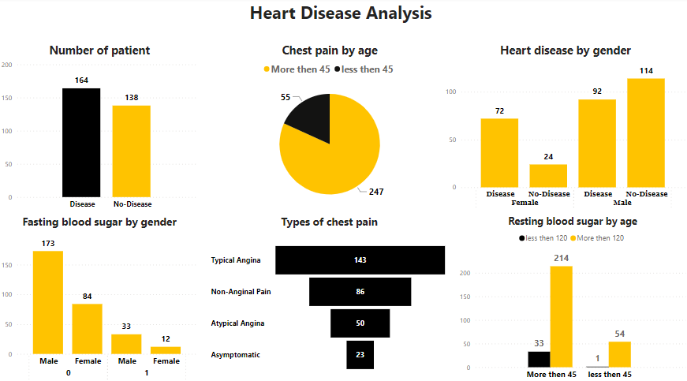
Dashboard

Slide 8

Thank You
SUNIL SINGH BAIST

